Slide 1



CRYPTO
CURRENCY PRICE PREDICTION
By Savita Khedekar

Slide 2
INTRODUCTION TO
CRYPTOCURRENCY
Cryptocurrency is a digital or virtual form of currency that uses cryptography for security. Unlike traditional currencies, it operates on a decentralized system called blockchain technology, ensuring transparency and immutability in transactions.

Slide 3


OVERVIEW
Introduction to Cryptocurrency Price Prediction : Cryptocurrency markets are highly volatile and subject to rapid price changes, making them both an intriguing and challenging subject for financial forecasting.
The Machine Learning Techniques. :Addressing in this project is the prediction of cryptocurrency prices using machine learning (ML) techniques. This is a time series forecasting problem where the goal is to predict future prices based on historical data
Objective : by leveraging machine learning to predict cryptocurrency prices, this project aims to provide valuable insights and tools for participants in the rapidly evolving world of digital assets.

Slide 4

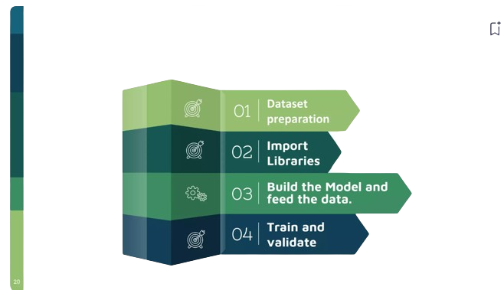





STEPS WISE PROCEDURE
DATA Prepartion
Source: The dataset used for this project primarily comes from Yahoo Finance.
Time Frame: The dataset covers a time span of last 10years , capturing both bull and bear markets.
Data Points: Includes daily data on Open, High, Low, Close prices, Trading Volume.
Import Libraries:
Data AnalysisVisualization:
pandas,matplotlib,seaborn
Machine Learning and Time Series and Deep Learning:
datetime as dt
sklearn
keras

Slide 5
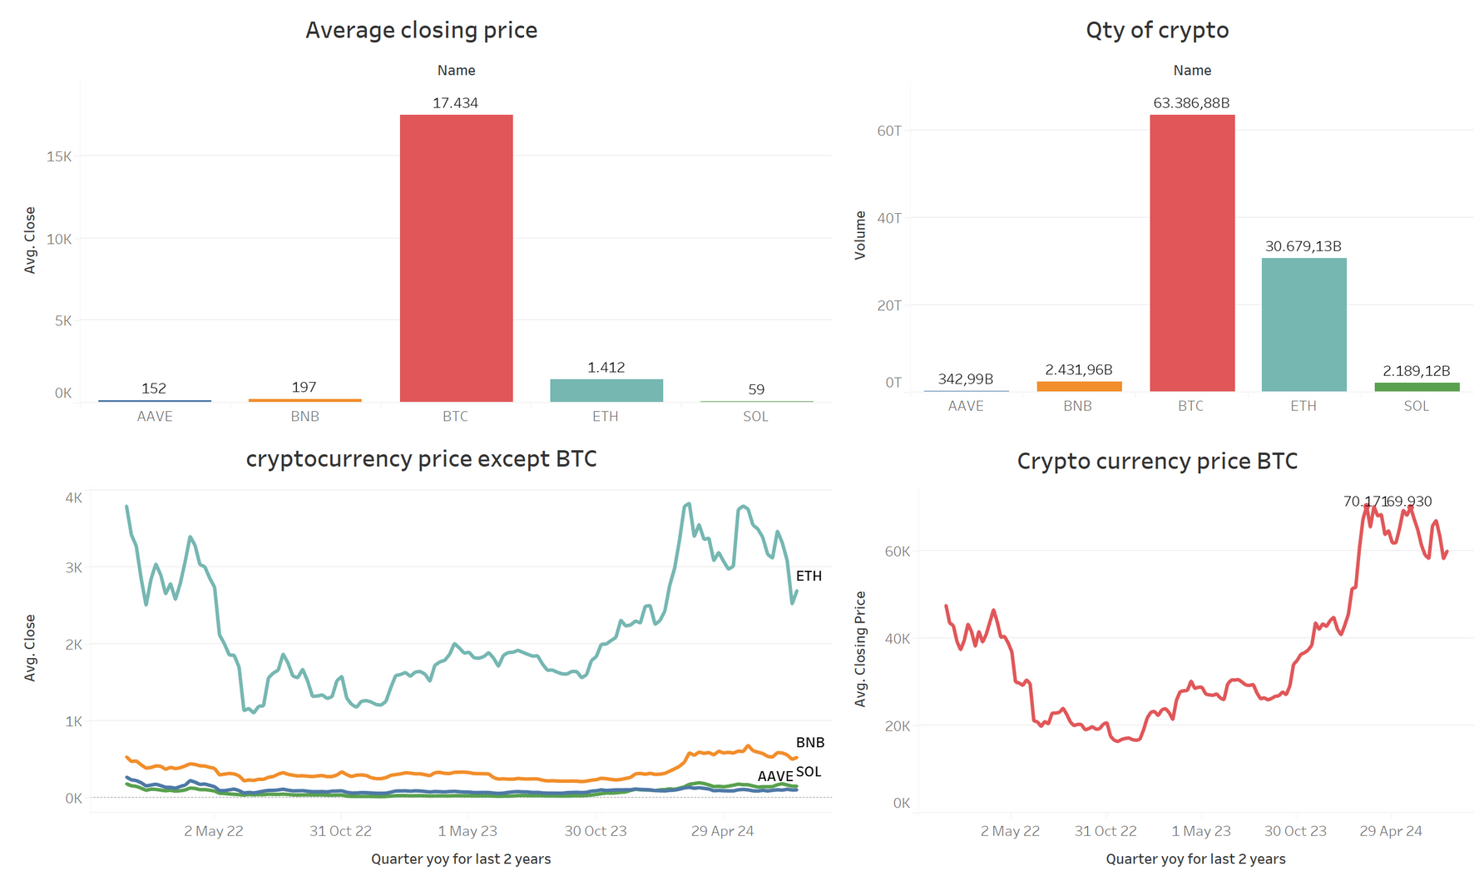
OVERVIEW OF TOP 5 CRYPTOCURRENCY

Slide 6
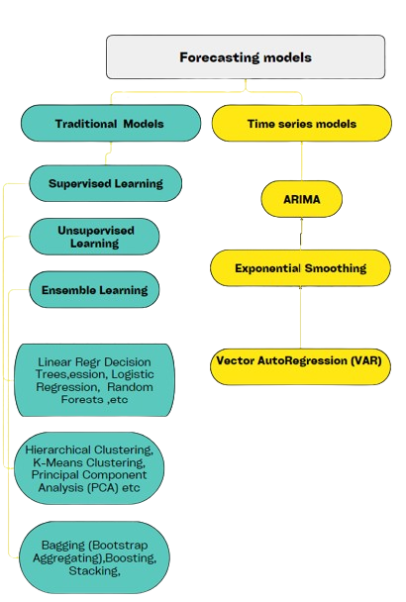
TIME SERIES VS. TRADITIONAL MACHINE LEARNING APPROACH
 | Time Series Data | Traditional Machine Learning Data
Nature of Data | Order of data points matters; each point is tied to a specific timestamp. (e.g.,Stock prices, weather) | Data points are independent; rows are observations, columns are features. (e.g., House prices, image classification)
Nature of Data | Order of data points matters; each point is tied to a specific timestamp. (e.g.,Stock prices, weather) | Data points are independent; rows are observations, columns are features. (e.g., House prices, image classification)
Feature Engineering | Focus on time-based features like trends and seasonality. Data cannot be shuffled | Features are independent of time; techniques like one-hot encoding and normalization are used. Data can be shuffled.
Feature Engineering | Focus on time-based features like trends and seasonality. Data cannot be shuffled | Features are independent of time; techniques like one-hot encoding and normalization are used. Data can be shuffled.
Feature Engineering | Focus on time-based features like trends and seasonality. Data cannot be shuffled | Features are independent of time; techniques like one-hot encoding and normalization are used. Data can be shuffled.
Model Selection | ARIMA, ETS, LSTM, GRU models for capturing temporal dependencies | Linear Regression, Decision Trees, SVM, Neural Networks for non-sequential data.

Slide 7
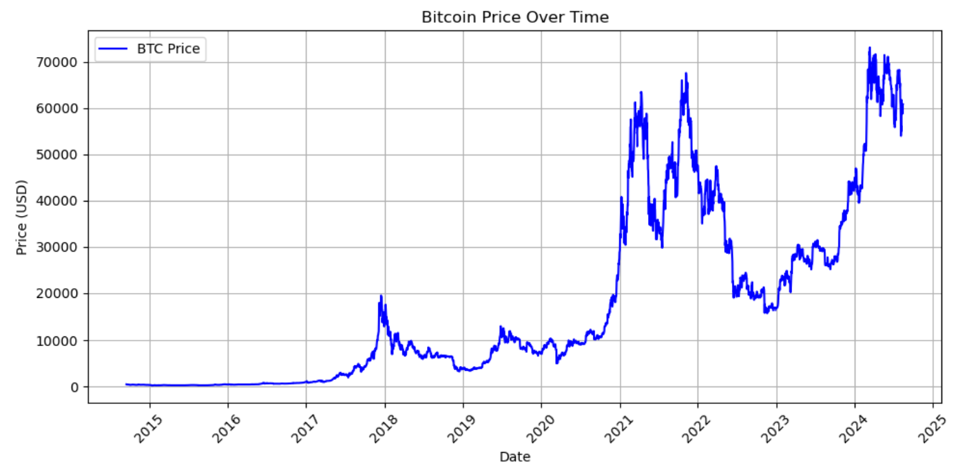
BITCOIN PRICE OVER TIME

Slide 8

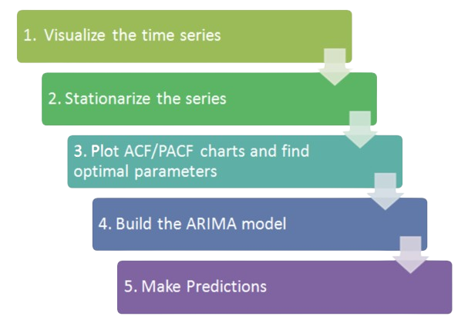

MODEL BUILDING -ARIMA
ARIMA model (AR) + (I) + (MA)

Slide 9
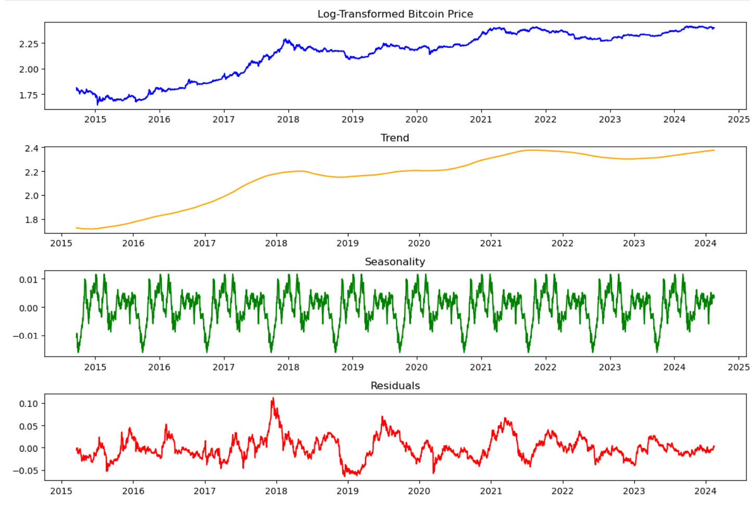
TIME SERIES DECOMPOSITION

Slide 10

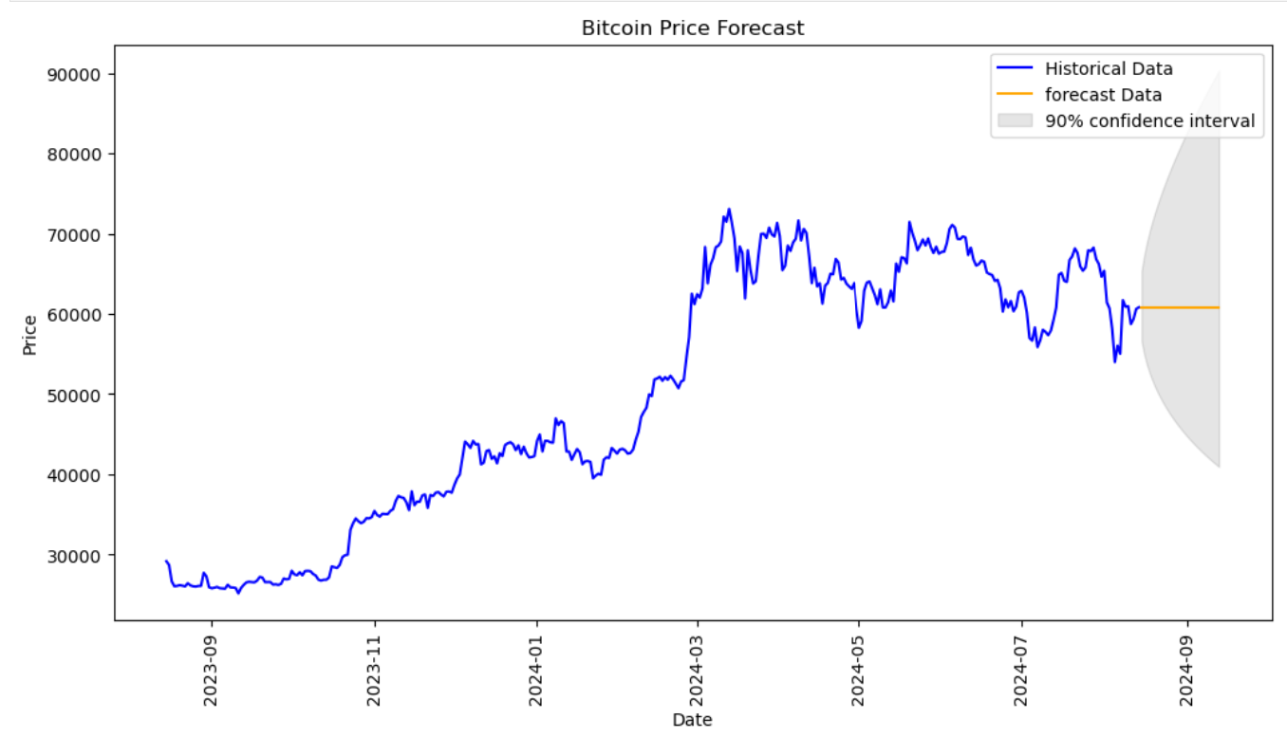
ARIMA FORECAST FOR 30 DAYS

Slide 11


THE MODEL AND SCORES
Model | Scores
ARIMA | MSE: 8.820786740305104e-06 RMSE: 0.002969980932650091
Time Series Cross-Validation | MSE: 0.5322739775117283 Test R² (NN): 0.4202676350329549
Long Short-Term Memory (LSTM) | MSE(NN): 5.218670510819259e-05 RMSE (NN): 0.007224036621459818 R² (NN): 0.9689457974923262

Slide 12


REAL-WORLD APPLICATION
Investment Decision-Making
Business Strategy and Innovation
Risk Management

Slide 13


FUTURE WORK AND IMPROVEMENTS
Enhancing Model Accuracy:
hybrid models combining deep learning with external sources social media sentiment, news articles, and macroeconomic indicators
Real-Time Prediction : Develop models capable of providing real-time predictions to support high-frequency trading and instant decision-making.
Scalability: Ensure the model can scale to handle larger datasets and more cryptocurrencies, adapting to the growing and evolving market.

Slide 14



CHALLENGES AND LEARNINGS
High Market Volatility
Challenge: Cryptocurrency markets are notoriously volatile, with prices often fluctuating wildly within short timeframes due to various factors like regulatory news, technological changes, and market sentiment.
Learning: Traditional models often struggle to cope with such volatility. A key takeaway is the importance of incorporating models that can adapt to rapid market shifts, possibly by integrating real-time data
Overfitting
Challenge: Overfitting is a significant risk, especially in complex models where the model may perform well on historical data but fail to generalize to future, unseen data.
Learning:Techniques like cross-validation, regularization, and the use of simpler models for comparison are important to prevent overfitting.

Slide 15
In conclusion, while predicting cryptocurrency prices is inherently challenging, this project has demonstrated that with the right data, models, and considerations, it is possible to create model which can predict more better.
CONCLUSION

Slide 16
THANK YOU!

